Slide 1

GDP Analysis- Assignment
From-
Riya Tyagi

Slide 2
Data Exploration
We have three datasets which are source from https://data.gov.in/, an Open Government Data (OGD) platform of India.
Data I-A:-This dataset consists of the GSDP (Gross State Domestic Product) data for the states and union territories in different time duration. This dataset contains 36 columns.
1st column- Items Description
2nd column- Duration
3rd – 35th column–States od India
36th column- All India GDP.
Data I-B:-This dataset is a group of different states of India. This dataset contains the distribution of GSDP among three sectors: the primary sector (agriculture), the secondary sector (industry) and the tertiary sector (services) along with taxes and subsidies. There is separate dataset for each of the states.
Data II:-This dataset contains the drop rates of 3 different education level- Primary, secondary and senior secondary across different states of India.

Slide 3
Problem Statement
As the chief data scientist at NITI Aayog, we have to provide top-level recommendations to the Chief Minister of various state, which will help them priorities areas of development for their respective states. Basically our overall goal is to help the CMs focus on areas that will foster economic development of their respective states.
So, to solve this problem we are focusing on GDP(Gross Domestic Product) of each state of India and based upon this we provide our recommendation to CM.

Slide 4
Data Cleaning and Analysis of Dataset 1-A:-
We identify that in dataset 1-A, state West Bengal has all the null values. So, we drop the West Bengal column from the dataset.
Delete the '(% Growth over the previous year)' and 'GSDP - CURRENT PRICES (` in Crore)' for the year 2016-17 in dataset 1-A.
Drop the column All India GDP from dataset 1-A because we want to analysis only for state of India.
Extract only 2013-14, 2014-15,2015-16 duration rows from the dataset to calculate the average GDP of the states of India.

Slide 5
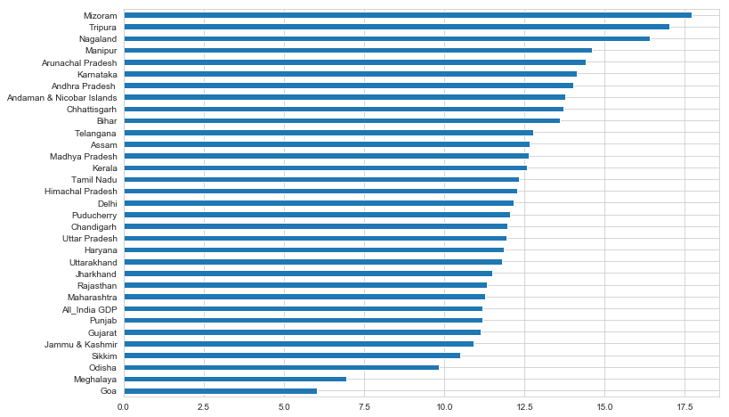
GDP mean of different states of India

Slide 6
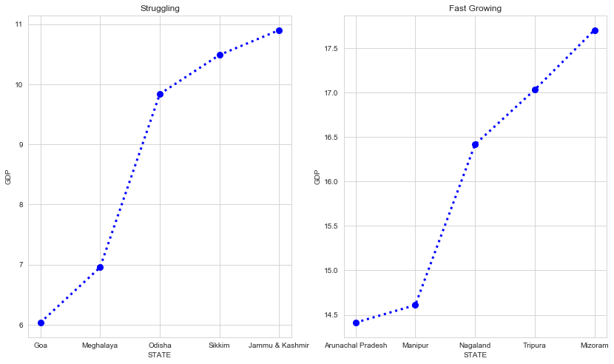
Top 5 Fast growing and Struggling states-

Slide 7
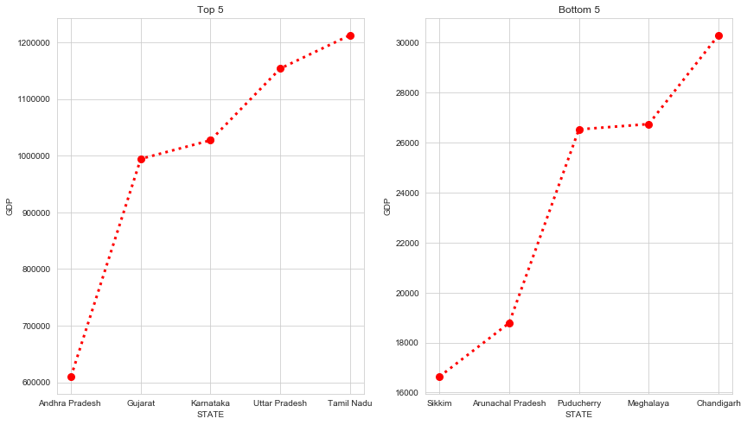
Top 5 and Bottom 5 states based on GDP

Slide 8
Data Cleaning and analysis of Data 1-B
Remove the Union territories states from our dataset like Chandigarh, Delhi, Dadra and Nagar Haveli, Daman and Diu, Lakshadweep, Andaman and Nicobar Island and Puducherry because they are governed by central government not state governments.
Merge all the state data in to one file for further analysis.
Extract only duration year 2014-15 data as we just need to analysis this year data.
Now, we are focusing on GDP per capita.

Slide 9
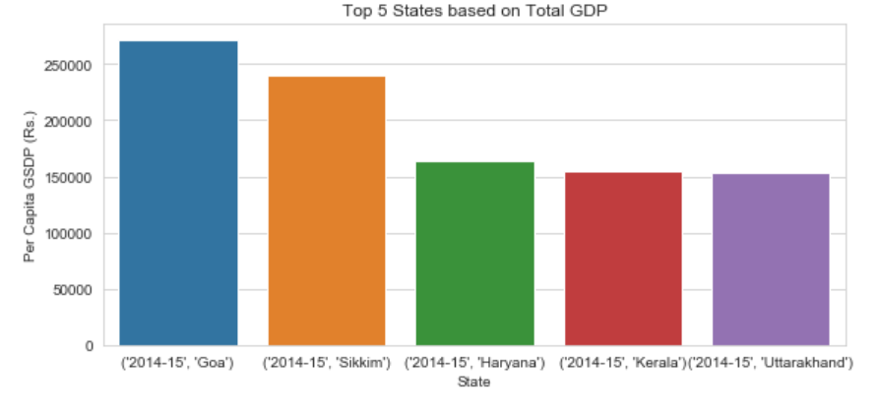
Top 5 states of India based upon GDP per capita

Slide 10
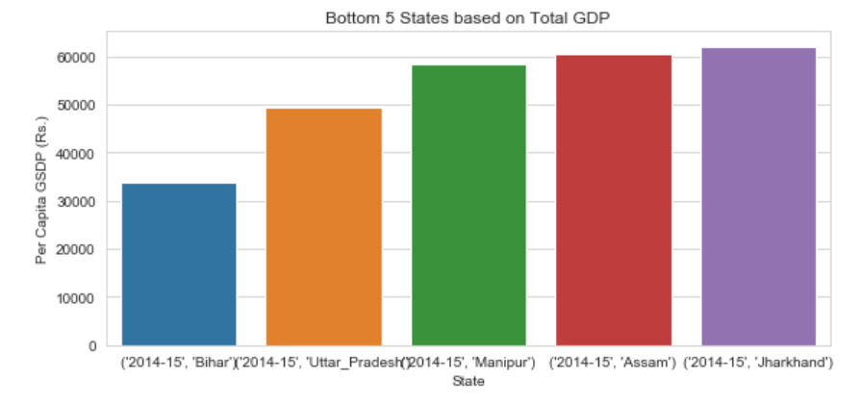
Bottom 5 states of India based upon GDP per capita

Slide 11
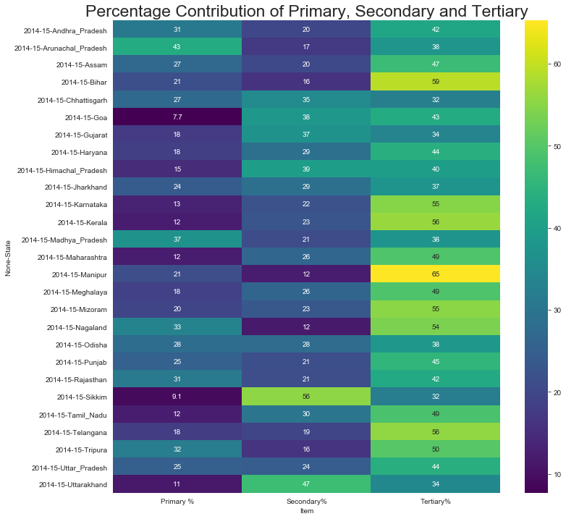
Percentage Contribution of Primary, secondary and Tertiary sectors across different states:-
In primary sector Arunachal Pradesh(43) has the highest contribution.
In secondary sector Sikkim(56) has the highest contribution.
In tertiary sector Manipur(65) has the highest contribution.

Slide 12
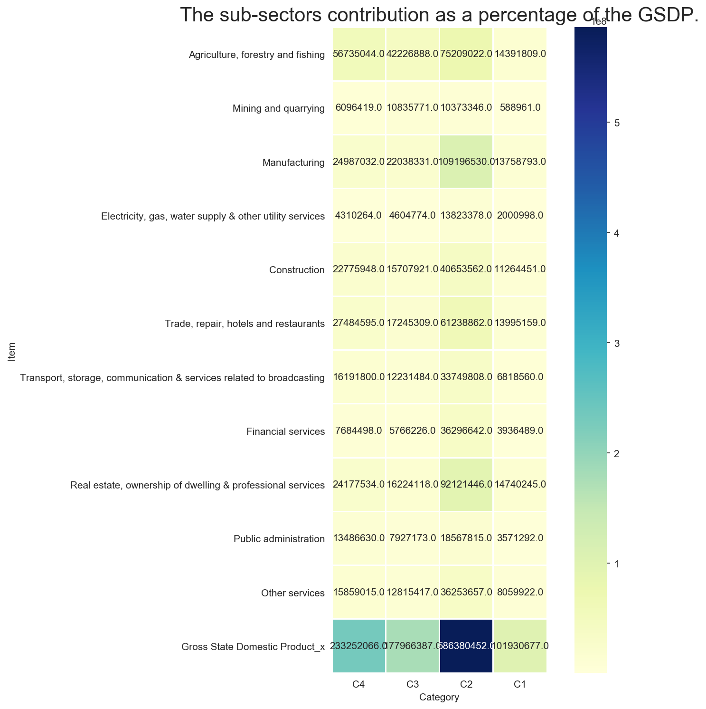
Sub-sector contribution in GSDP across all four categories-
C1 category states need to work in ‘Mining and quarrying’ sub-sector for improvement.
C2 category states have less contribution from the sub-sector ‘Mining and quarrying’.
C3 Category need to work on sub-sector ‘Electricity, gas, water supply & other utility services’.
C4 Category have to focus on sub-sector ‘Electricity, gas, water supply & other utility services’.

Slide 13

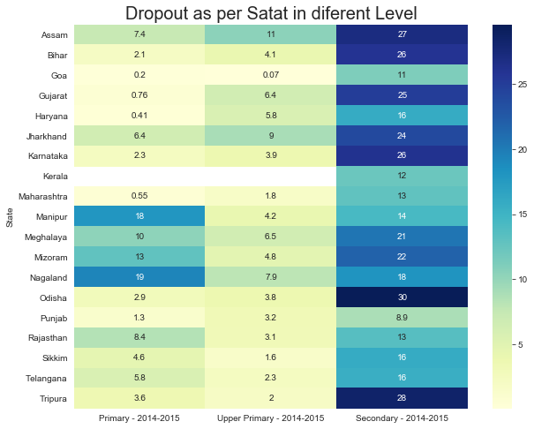

Slide 14
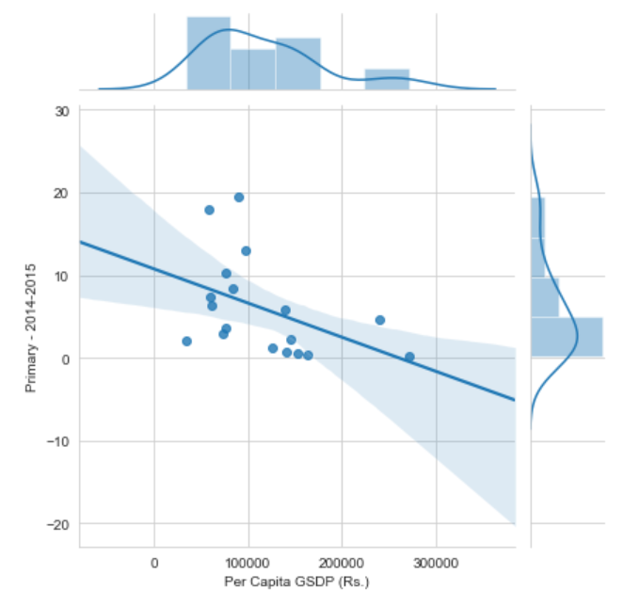
Correlation GDP per Capita vs Primary level Dropout for 2014-15

Slide 15
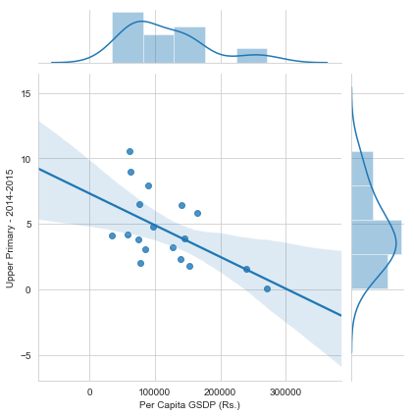
Correlation GDP per Capita vs Upper Primary level Dropout for 2014-15

Slide 16
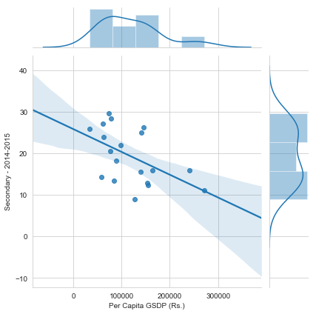
Correlation GDP per Capita vs Secondary level Dropout for 2014-15

Slide 17
RECOMMENDATION
We have to focus on Primary sectors because they have less rate in compare of all other three.
‘Mining and quarrying’ and ‘Electricity, gas, water supply & other utility services’ sub-sectors need more facility. So that they can improve in their respective areas and overall in state growth.
Provide proper guidance in people about the secondary level of education because most of students drop in secondary level which is not a good part of state growth.
As Uttar Pradesh having large number of population so we can increase the GDP per capita their very easily by provide work to the people which will surely increase the GDP of the state as well as of our country also.

